Slide 1



Your Name
Title
NMLS #XXXXXX
Email:
Phone:
Mortgage 101

Slide 2

Pre-Approval
HELPS YOU KNOW:
DOCUMENTS NEEDED:
Amount of monthly payment you can afford
Down payment amount you will need
2 years of tax returns and W-2’s
Employment history
1 month of pay stubs
3 months of savings/checking account statements
Copy of your driver's license

Slide 3
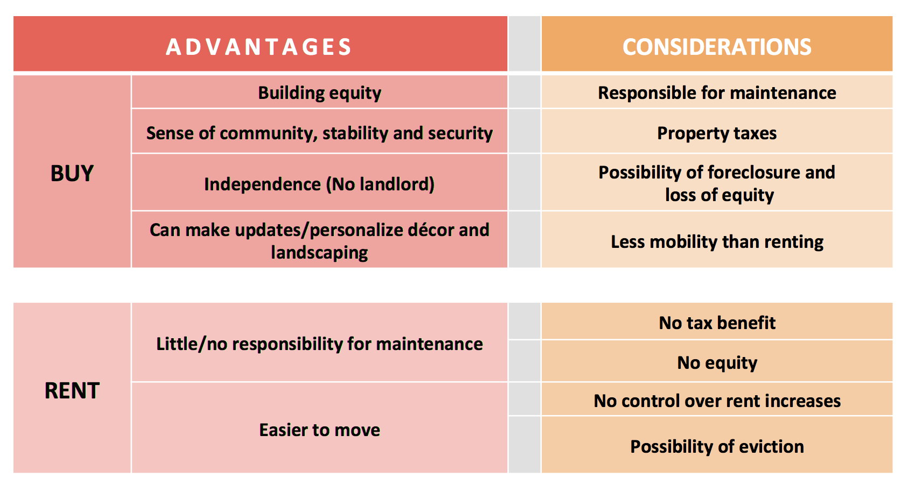

Slide 4

There are a lot of choices!
What mortgage is good for you?
Loan Types
Loan Programs
Down Payment

Slide 5

Conventional
  3% or more down payments
  620 credit score and above
FHA
  3.5% percent down
  Programs available down to 600 credit scores
VA
  100% financing
  Borrower can buy with 0% down
Loan Types

Slide 6

Umbrella of FHFA

Slide 7
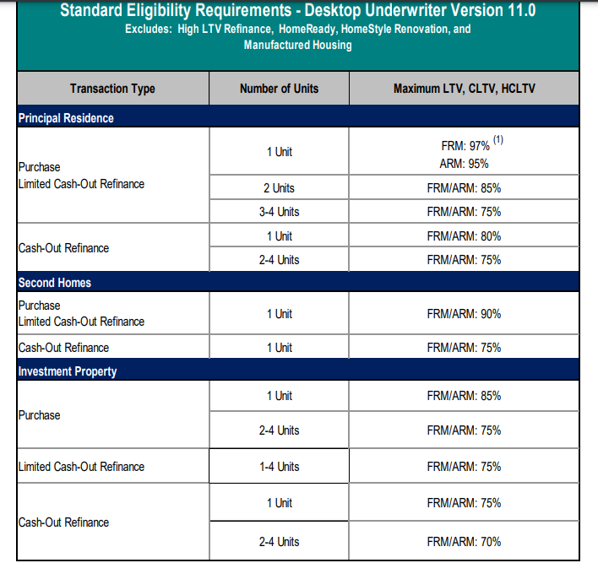
Fannie Mae Guidelines
DTI= 49%
Down payment
  owner occupied vs. Non-owner occupied
Rate Fluctuation

Slide 8
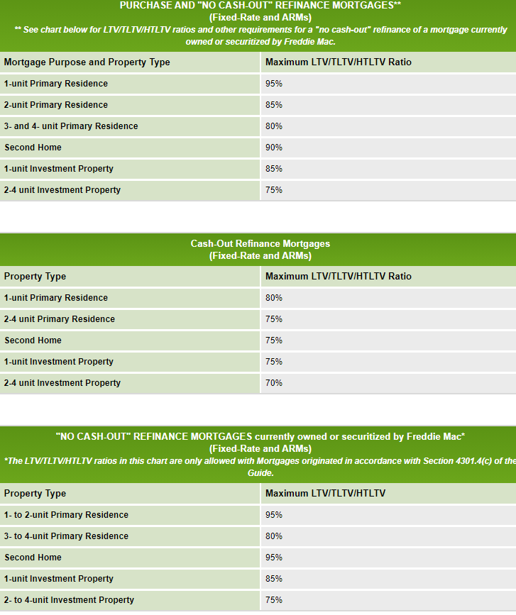
Freddie Mae Guidelines
DTI
Down payment
  owner occupied vs. Non-owner occupied
Rate Fluctuation
Biggest Differences
  Allows 1 year of self-employed income IF he/she has been self-employed for more than 5 years
  ½% on student loan debt

Slide 9

The Mortgage Trinity
Assets | Credit | Income
What is acceptable during the mortgage process?

Slide 10

Acceptable Types of Assets For A Mortgage Loan
Checking Accounts
Savings Accounts
Money Markets
401k
Stocks/Bonds
The documented sales of funds such as a bill of anything
(from a home, to a boat, to a piece of jewelry)
Gift
Local County/State Program & Grants

Slide 11

WHAT MAKES A CREDIT SCORE?
We use the median of the three and use the lowest of the two borrowers
Recently, the AUS approval will be based off the average of the FICO scores

Slide 12
WHAT MAKES A CREDIT SCORE?

Slide 13
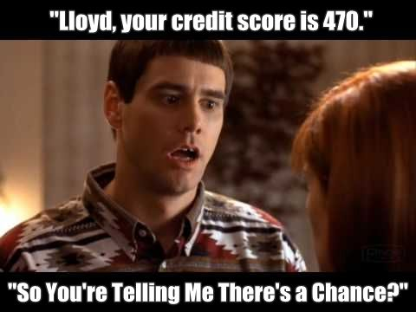
“Less than perfect” credit solutions
FHA Loans
Success Mortgage Partners offers financing down to 600 Credit Scores through FHA.
Loan must be approved through Automated Underwriting.

Slide 14

INCOME
SHOW ME THE MONEY!
Debt To Income
FHA: 57 DTI
Conventional: 50 DTI
VA: Case by case on DTI

Slide 15

REFINANCE
Types
  Rate/Term
  Cash-Out (Debt Consolidation, Home Improvements, Investment, etc.)
Equity Position – 80% LTV
  Say goodbye to PMI
Leverage your debt to make more money

Slide 16
Our core values drive us to deliver unmatched service while making dreams come true!

Slide 17

I appreciate the opportunity to work with you!
Your Name
Title
NMLS #XXXXXX
Email:
Phone:

