Slide 1
Economics
Of Housing

Slide 2
Economics of Housing
Supply
Demand
Inflation
Mortgage Rates

Slide 3
Key Drivers of Supply
New Construction
Pending Home Sales
Foreclosures

Slide 4
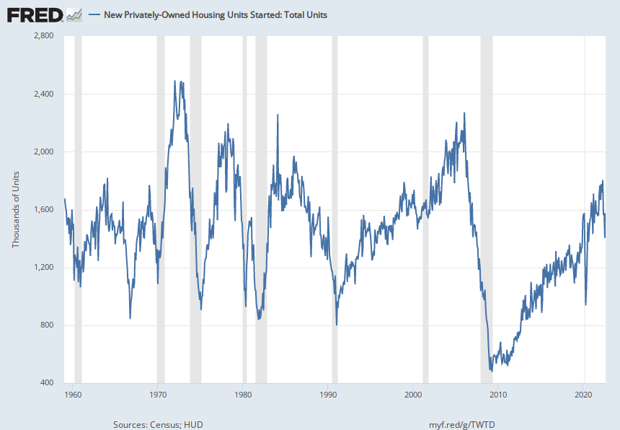
Housing Starts

Slide 5
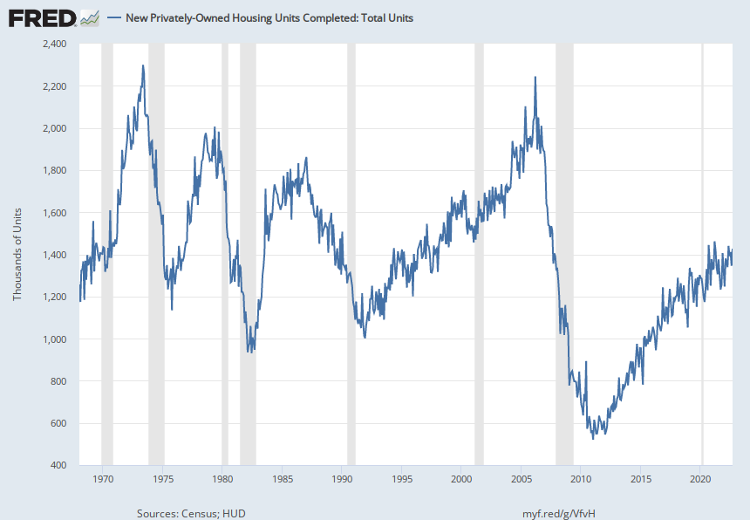
Housing Completions

Slide 6
Housing Formula
Source: MBS Highway

Slide 7
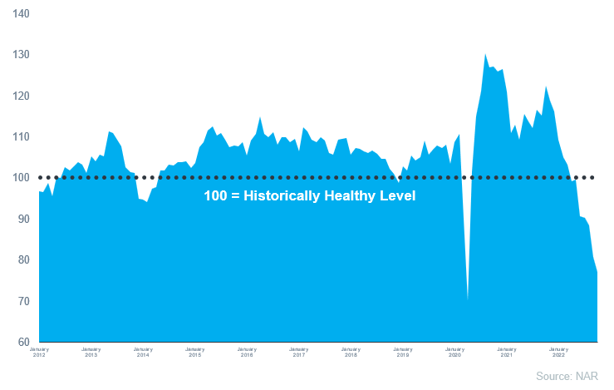
Pending Home Sales

Slide 8
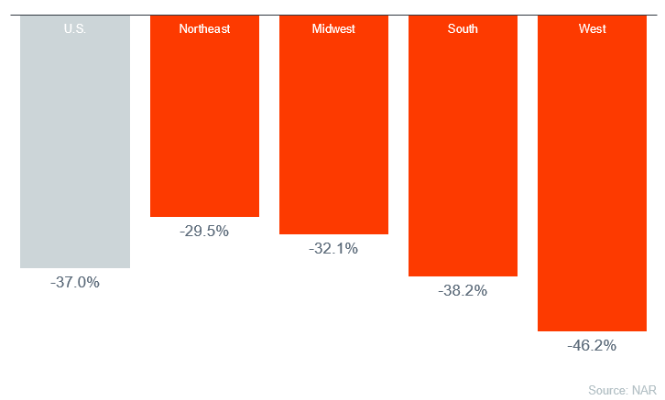
Pending Home Sales – YOY by Region

Slide 9
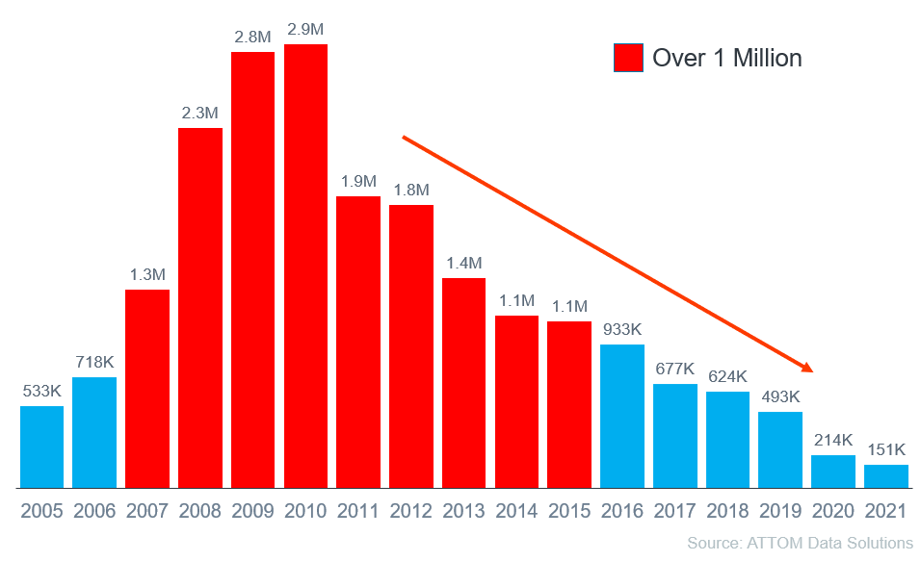
Foreclosure Activity by Year

Slide 10
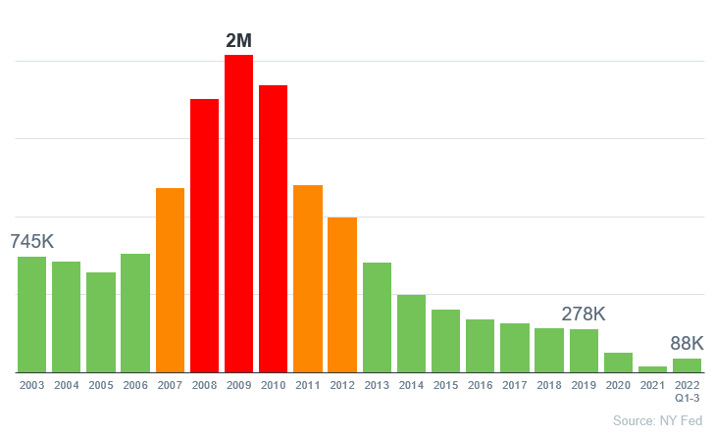
Foreclosure Activity: 2022 thru Q3

Slide 11
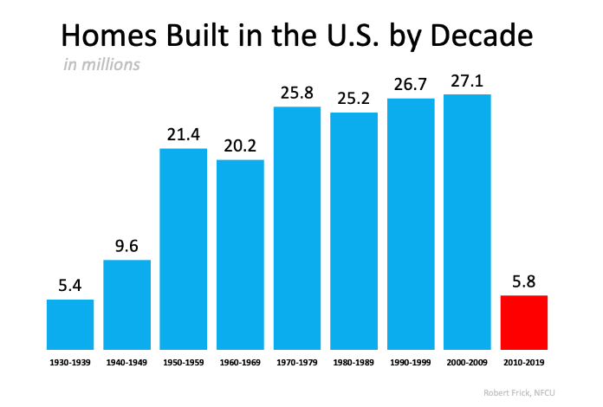
New Construction

Slide 12
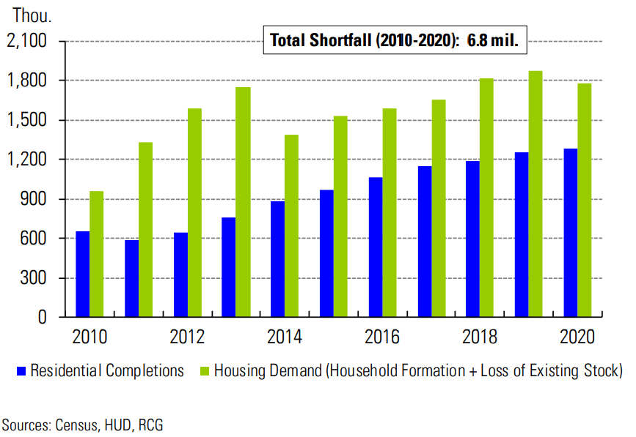
Housing Supply Demand Gap
Source: MBS Highway

Slide 13
Key Drivers of Demand
Household Formations
Mortgage Rates
Affordability
Rents

Slide 14
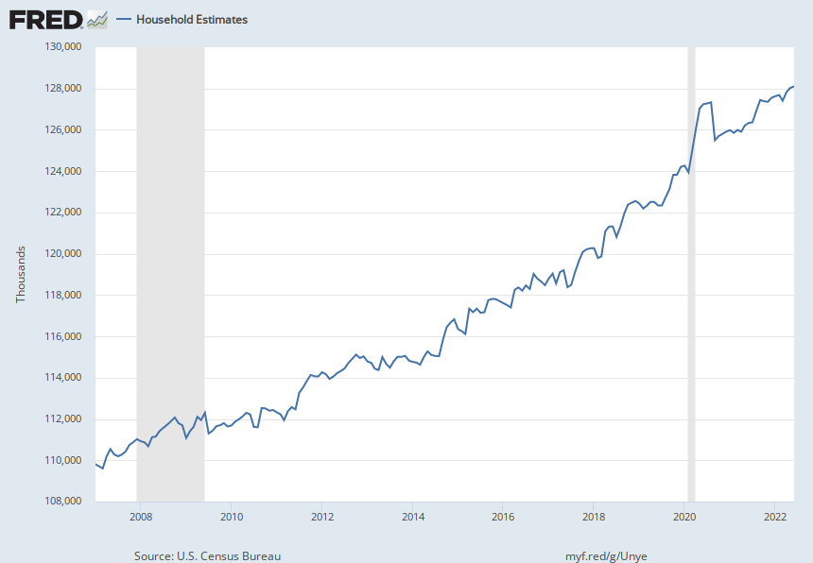
Household Formations

Slide 15
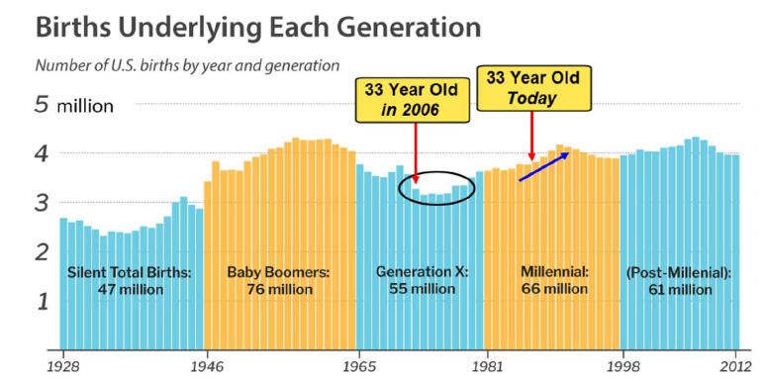
Household Formations
Source: MBS Highway

Slide 16
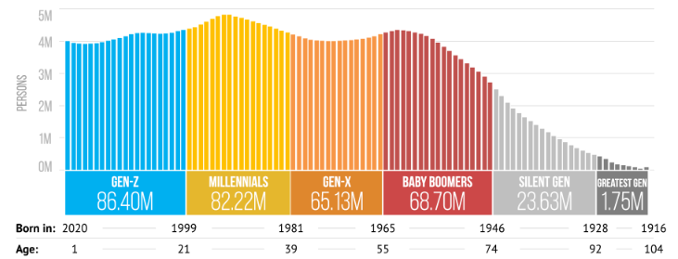
Generational Breakdown
Source: US Census Bureau

Slide 17
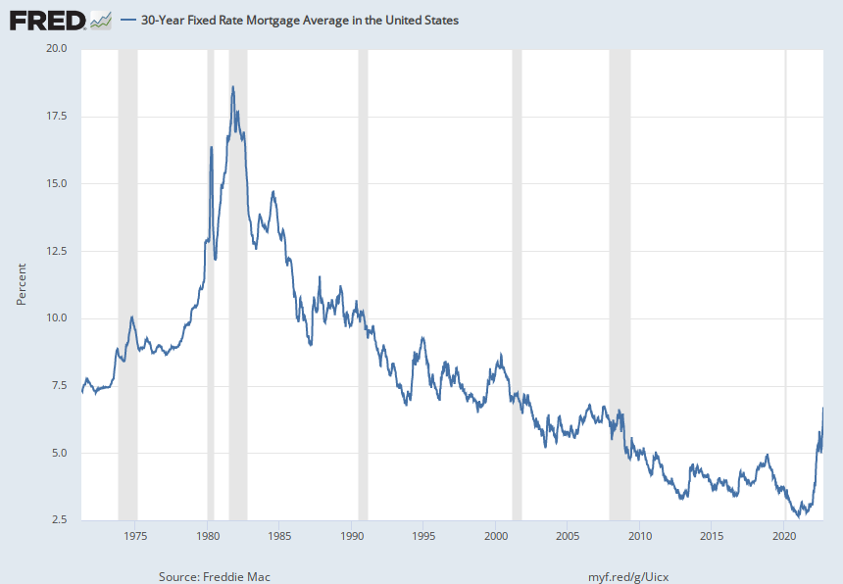
Mortgage Rates – 50 Year History

Slide 18
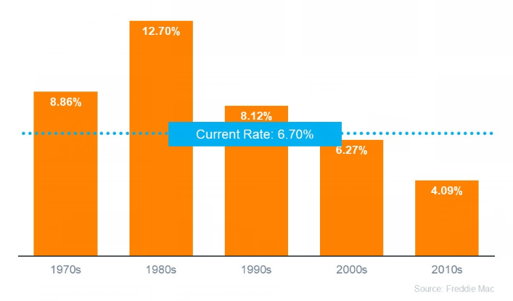
Mortgage Rates by Decade

Slide 19
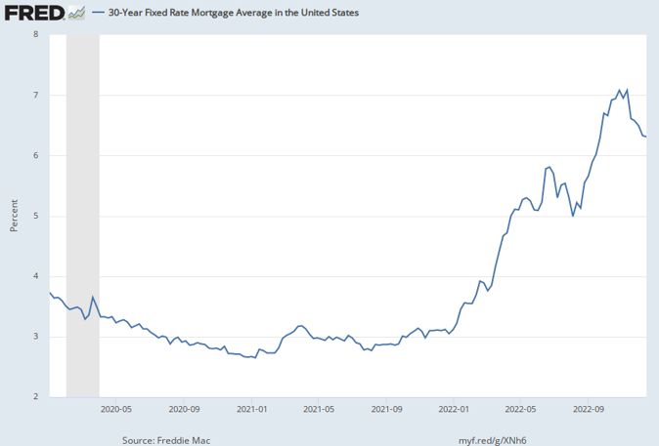
Mortgage Rates: 2020-2022

Slide 20
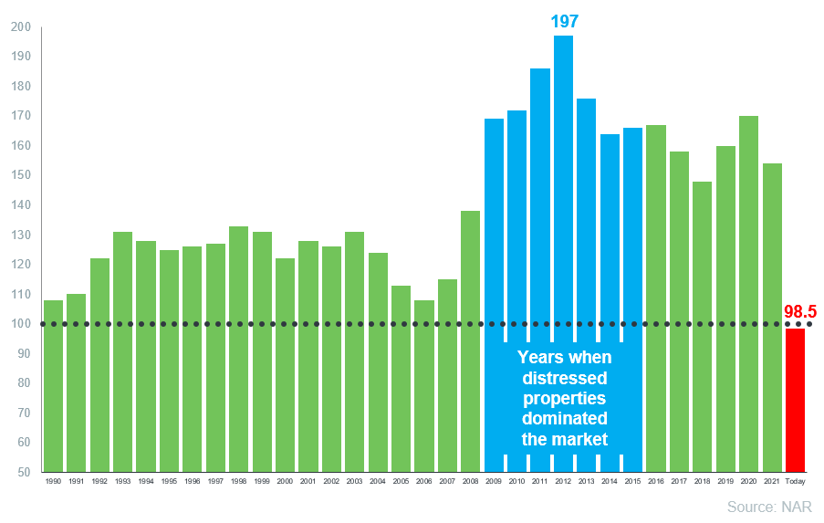
Housing Affordability Index

Slide 21
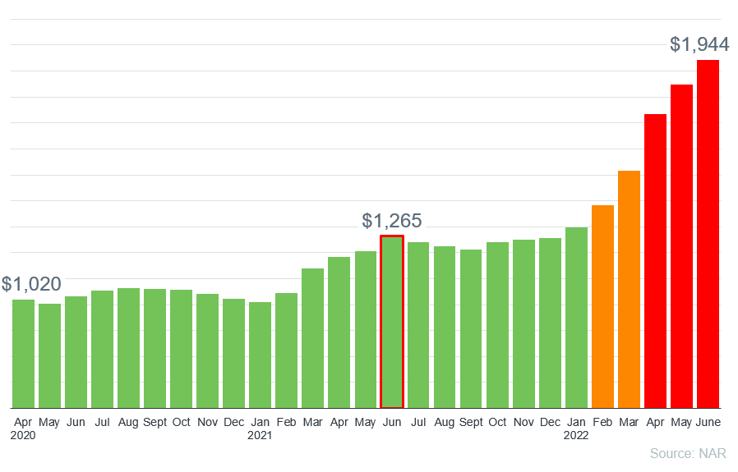
Monthly Mortgage Payments

Slide 22
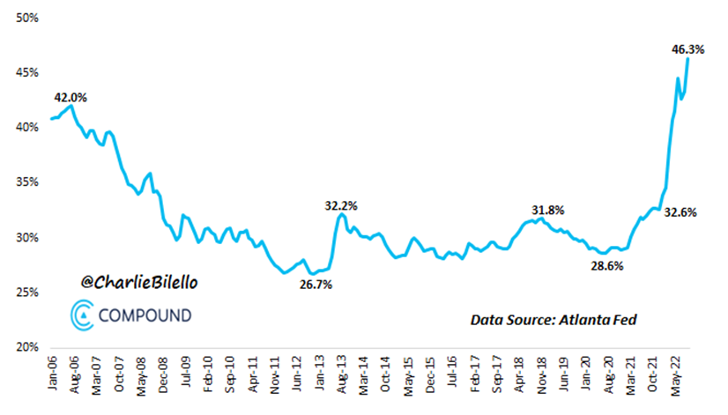
Monthly Payment as % of Income

Slide 23
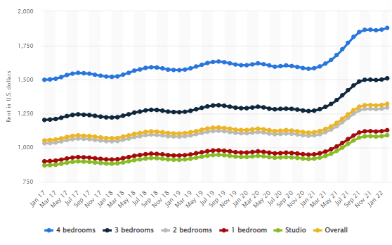
US – Avg Monthly Apartment Rents
Source: Statista

Slide 24
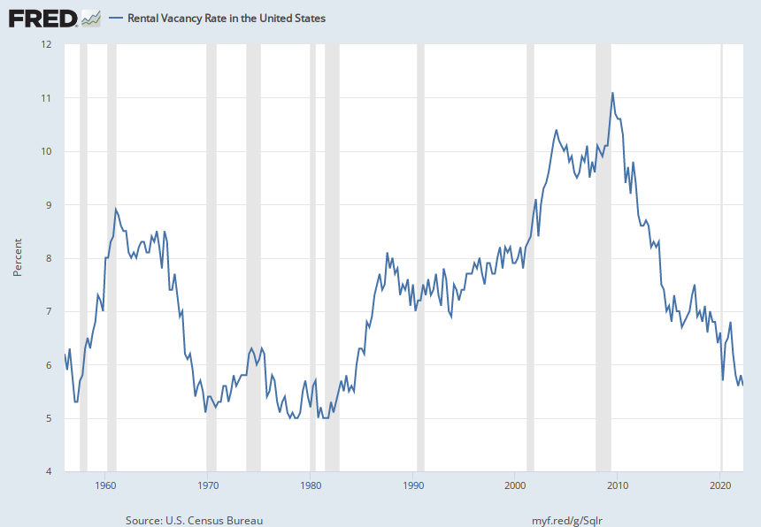
Rental Vacancy Rates

Slide 25
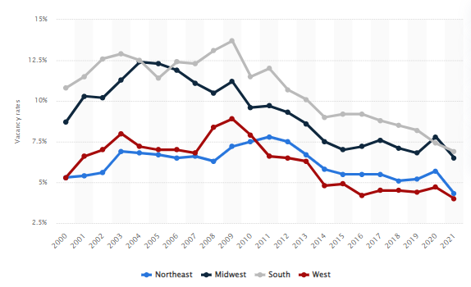
Rental Vacancy by Region
Source: Statista

Slide 26
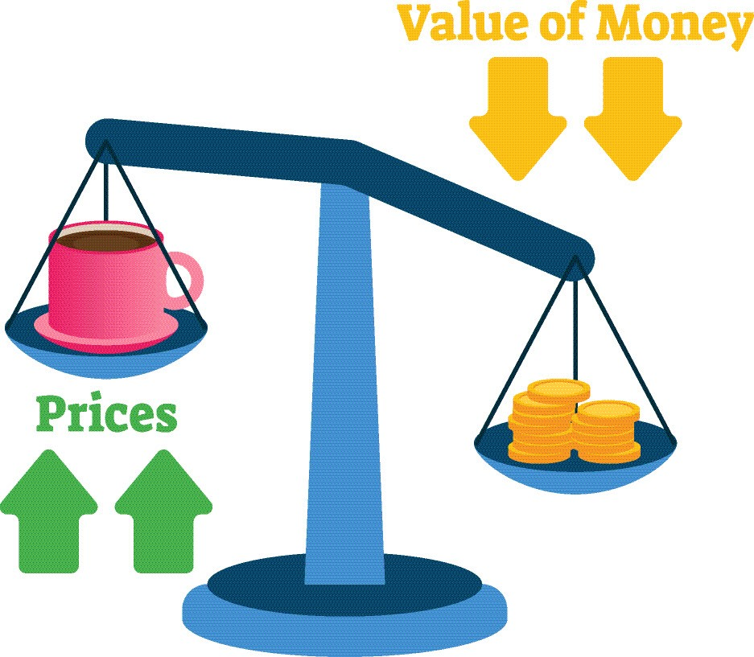
Key Drivers of Inflation
Consumer Spending
Cost of Goods
Employment Wages
Policies & Regulations

Slide 27
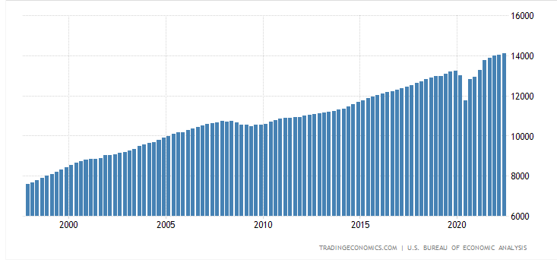
Consumer Spending

Slide 28
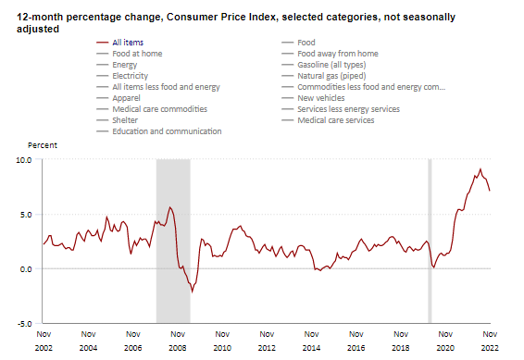
Cost of Goods

Slide 29
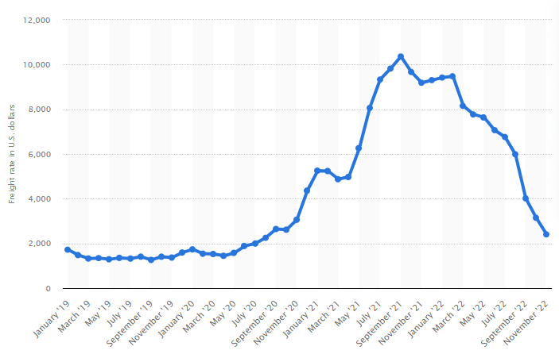
Shipping Container Costs
Source: Statista

Slide 30
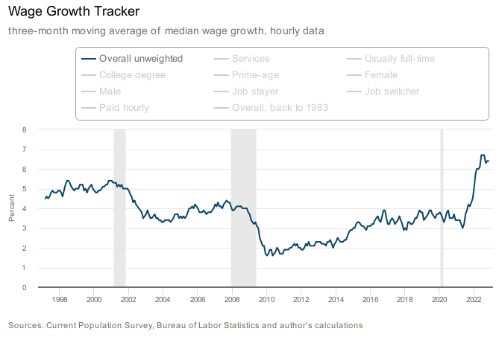
Employment Wages

Slide 31
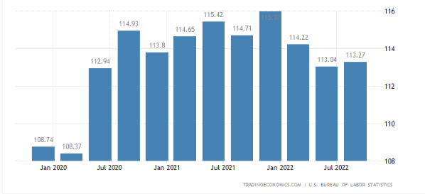
Wages & Productivity

Slide 32
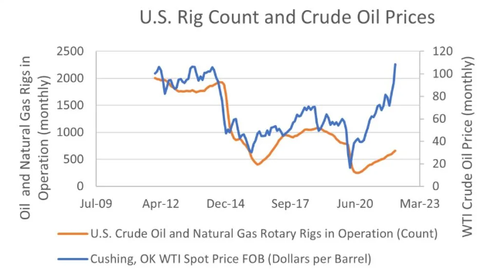
Policies & Regulations
Source: Heritage Foundation

Slide 33
Cost - Gasoline Per Gallon
Source: Y-Charts

Slide 34
Key Drivers of Mortgage Rates
Employment
Inflation
Stocks & Bonds
Economics

Slide 35
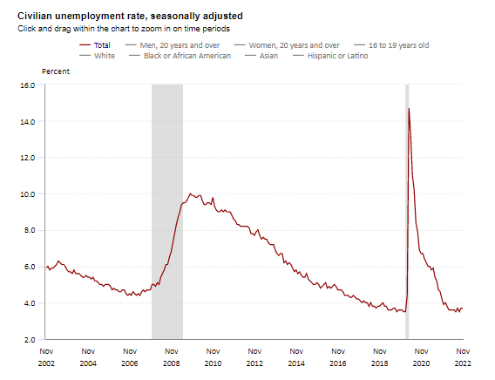
BLS Unemployment Report

Slide 36
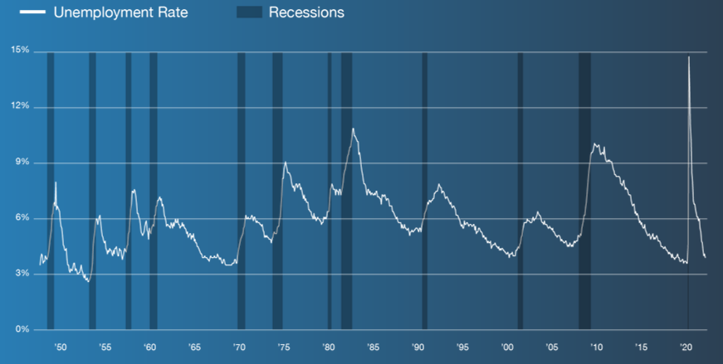
Unemployment & Recessions
Source: MBS Highway

Slide 37
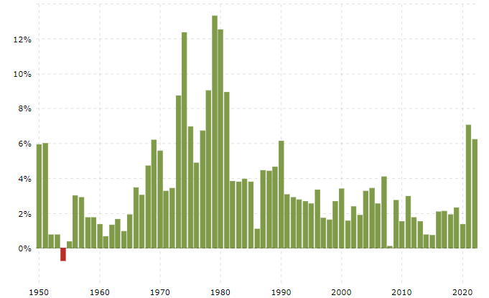
Inflation: 1950 to Present
Source: Macrotrends

Slide 38
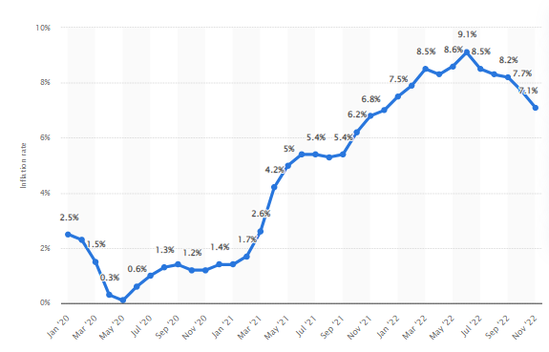
Inflation: 2020 - 2022
Source: Statista

Slide 39
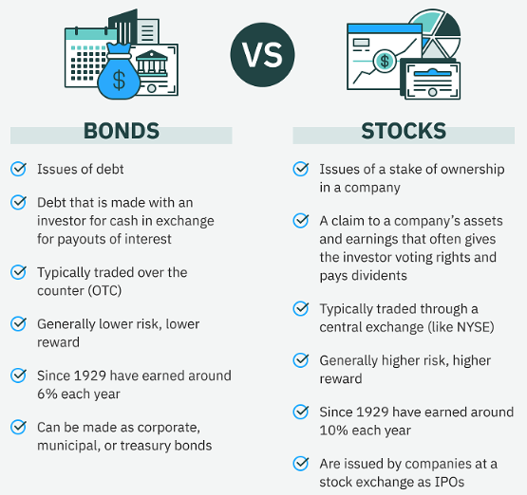
Equities vs Fixed Income
Source: Tokenist

Slide 40
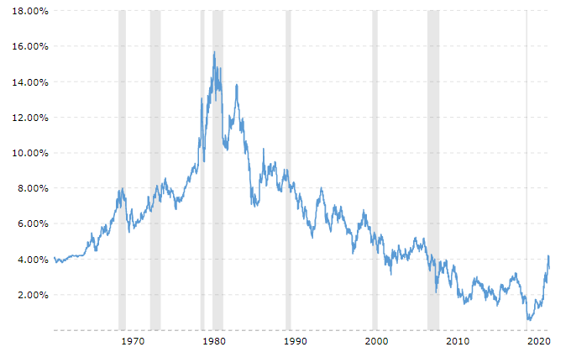
US – 10 Year Treasury Bill
Source: Macro Trends

Slide 41
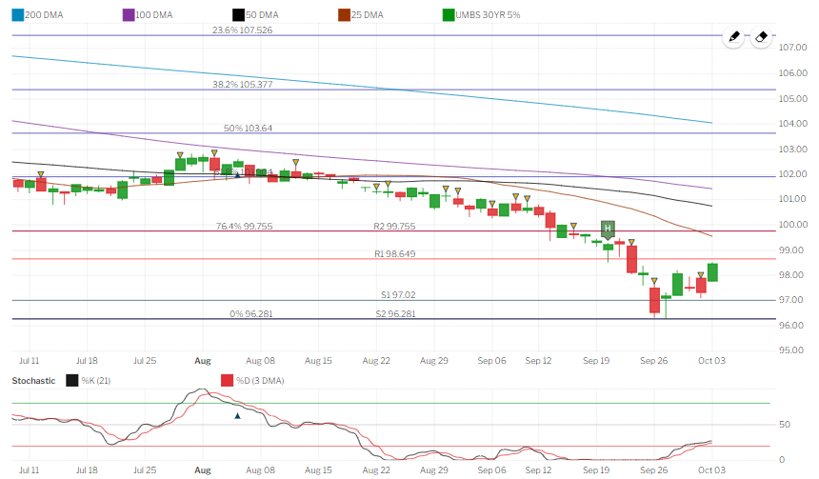
Mortgage-Backed Security
Source: MBS Highway

Slide 42
Key Economic Drivers
Recessions
Home Values
Supply & Demand
Credit
Inflation

Slide 43
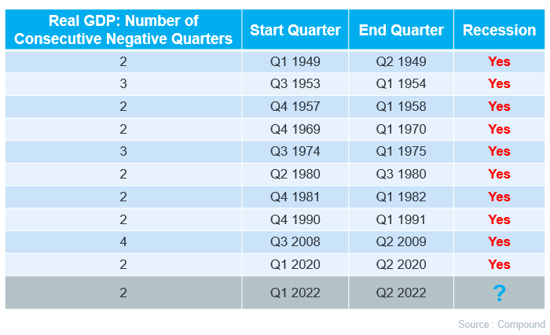
Recession or Not?
Source: MBS Highway

Slide 44
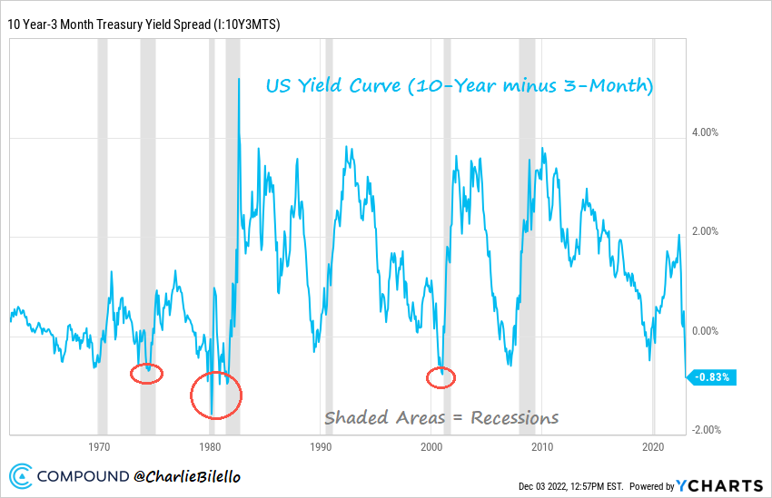
Recessions & Bond Yields

Slide 45
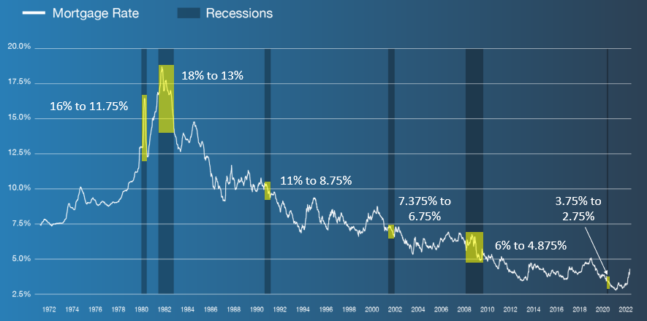
Recessions & Interest Rates
Source: MBS Highway

Slide 46
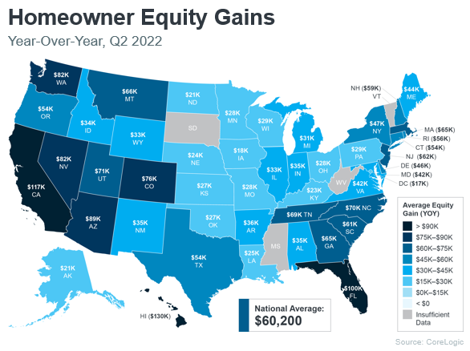
Home Values

Slide 47
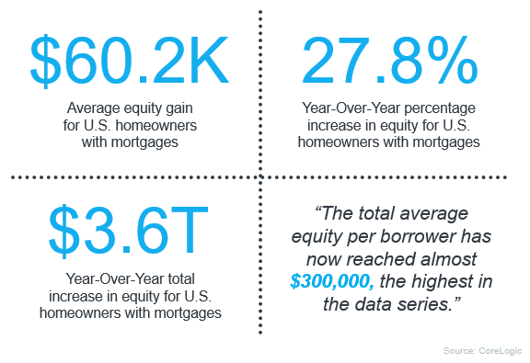
Home Values

Slide 48
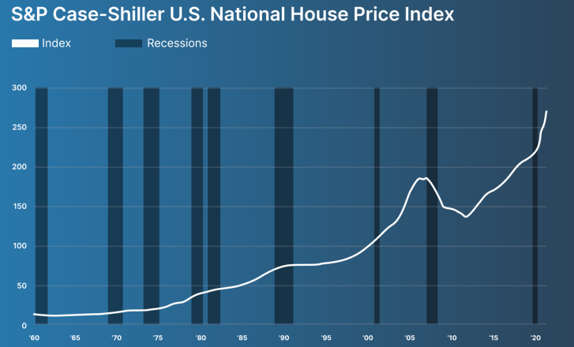
Recessions & Home Values
Source: MBS Highway

Slide 49
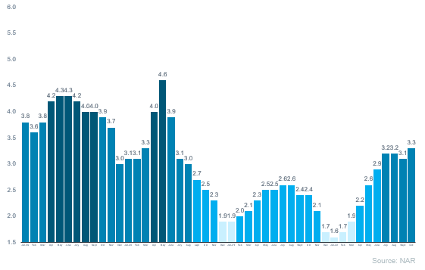
Home Inventory: 2019 - 2022

Slide 50
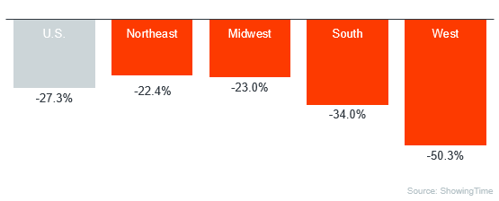
Buyer Demand: YOY Showings
Source: Showing Time

Slide 51
Housing Bubble?
Source: MBS Highway

Slide 52
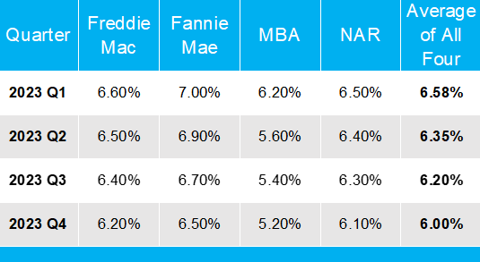
2023 Mortgage Rate Forecast – 12/22

Slide 53
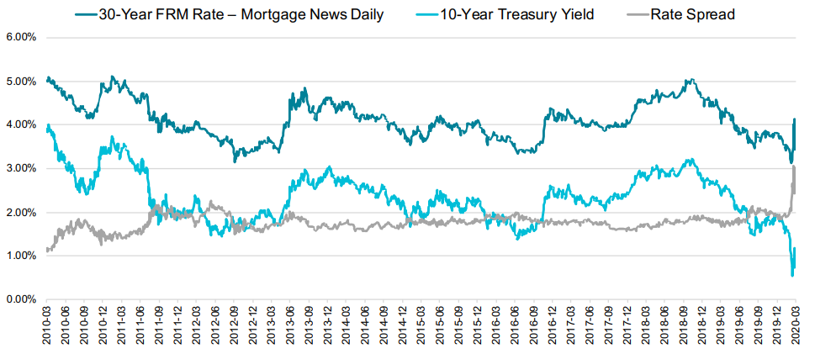
Spread: 30 Yr Fixed vs 10 Yr T-Bill
Source: Black Knight

Slide 54
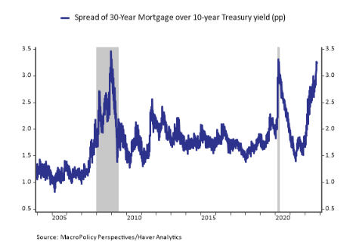
Spread: 30 Yr Fixed vs 10 Yr T-Bill

Slide 55
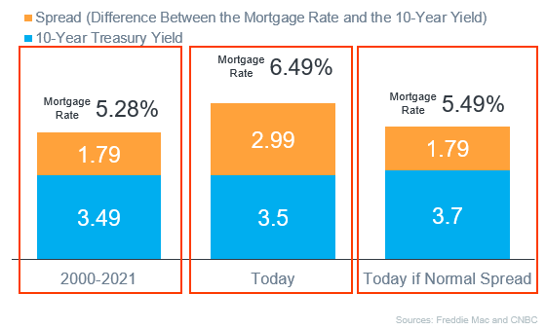
Spread: 30 Yr Fixed vs 10 Yr T-Bill

Slide 56
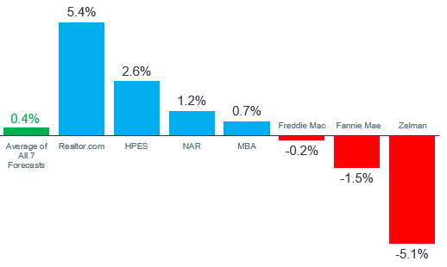
2023 Home Value Forecast

Slide 57
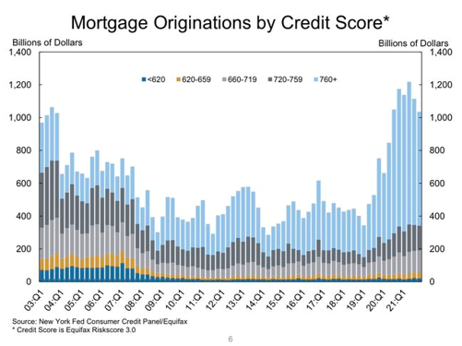
Loan Volume By Credit Score

Slide 58
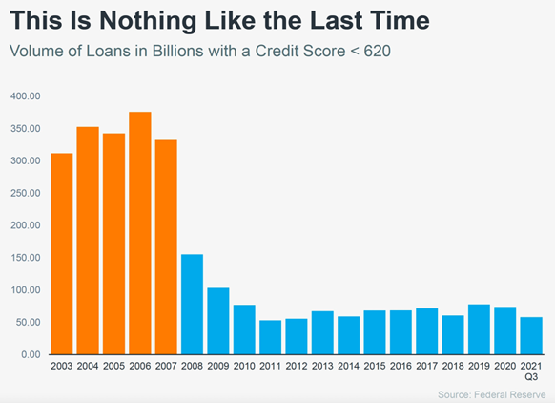
Credit Quality

Slide 59
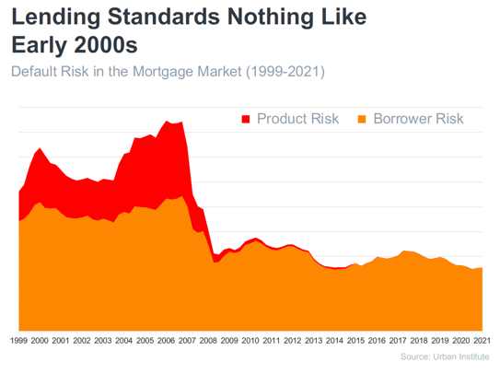
Product Quality

Slide 60
When Will Inflation Peak?
Source: MBS Highway

Slide 61
When Will Inflation Peak?

Slide 62
When Will Inflation Peak?

Slide 63
Inflation Has Peaked!
Source: Statista

Slide 64
Permanent Buydown: Seller credit $5,000
7.00% to 6.00% - cost $7,500
$150 mo – break even = 50 months
Temporary Buydown: Seller credit $5,000
7.00% to 6.00% - $300 x 12 months = $3,600
7.00% to 5.00% - $600 x 12 months = $7,200
Seller credit of $10,800

