Slide 1
PRODUCTION GOAL SETTING FOR 2023
AGENT SUCCESS COOKBOOK

Slide 2
MY WORD OF INTENT FOR THE YEAR!

Slide 3
How much do you want to earn this year?
What is your average basis point goal for your commissions this year?
What is your expectation for Buyers versus Listings this year?

Slide 4
LET'S BREAK THAT DOWN

Slide 5
LET'S EXPLORE YOUR SOURCES OF BUSINESS
Financial Advisors
Divorce Attorneys
Title Reps and Closers
Seminars | Workshops
Social Media
Neighborhood Groups | HOAs
Community Sponsorships
Open Houses
Past clients | database
For Sale By Owner Conversions
Friends and Family
Kids' Sports Teams
Parent Groups | Your kids' activities
Club Memberships
Networking Groups

Slide 6
LET'S LOOK AT HIGH LEVEL ACTIVITIES (HLA'S) THAT WILL HELP GENERATE BUSINESS FROM EACH CATEGORY

Slide 7
ACTIVITIES FOR OBTAINING MORE BUSINESS FROM FINANCIAL ADVISORS:
Drop by with Your Business Swag and introduce yourself - define your geo area, and your Designations
Communicate - Put them on a weekly Drip - Call once a month – Pop by once a quarter
Exchange 25 Business Cards for a mutual referral system - ask them to define their best client
Connect on all Social Media channels - support their business page - if they don't have one refer them to a vendor to create
Include them in sponsorship and networking events - make them part of your affinity group

Slide 8
ACTIVITIES FOR OBTAINING MORE BUSINESS FROM DIVORCE ATTORNEYS:
Drop by with Your Business Swag and introduce yourself - define your geo area, and your Designations | Certifications
Discuss what their challenges are with divorcing couples that own property - Offer Broker Price Opinion for property value
Exchange 25 Business Cards for a Mutual Referral System - ask what is the best way to refer them, what are their strengths
Connect on all Social Media channels - support their business page - if they don't have one refer them to a vendor to create
Include them in sponsorship and networking events - make them a part of your affinity group
Use Strategic Gifting
Take them to local chamber lunch for networking and introductions
Introduce them to a Certified Divorce Lending Professional and partner for success

Slide 9
ACTIVITIES FOR OBTAINING MORE BUSINESS FROM TITLE REPS AND CLOSERS:
Connect with last three title companies and ask for a Google Review
Offer to meet with their next FSBO for free contract review & offer buyer representation to the Seller on their purchase
Find a local title company training room and partner for Buyer's Seminar
Discuss Networking group opportunities they are involved in and attend as a guest
Exchange 25 Business Cards for a mutual referral system - ask them to define their best client
Use Strategic Gifting
Coordinate with title closer to get a testimonial/review of your services from your client at closing
Partner with title for swag like tax rates, school information, area demographics, and do popbys together

Slide 10
ACTIVITIES FOR OBTAINING MORE BUSINESS FROM SEMINARS | WORKSHOPS:
Research and identify workshops that First Time Homebuyers might go to like preparing for taxes, cooking classes, etc
Sponsor above workshops or create/develop your own
Stuff swag bags for attendees with your promos and information - have relevance to the current market activity
Become friends on Social Media to stay in touch
Supply branded bags or folders for attendees to the facility
Become a speaker and develop your own class
Write a book of tips and information to First Time Homebuyers and present from it
Start a Podcast

Slide 11
ACTIVITIES FOR OBTAINING MORE BUSINESS FROM SOCIAL MEDIA:
Become active and engaged in at least one Channel: Facebook, Instragram, TikTok
Make regularly scheduled videos and post using online Planner
Friend and Connect with Family, Neighbors, Clients, Vendors, Business Owners
Daily Block your calendar to comment and share, do not just "Like"
"Like" area businesses, regularly review, interview owners and proprietors
Run Contests and Make Announcements from your page
Create Neighborhood and Interest pages and manage. Comment from these pages for added engagement
Connect to other Social Media and link your accounts to simultaneously post
Learn to do videos to project your expertise and post to reels, stories, TikTok

Slide 12
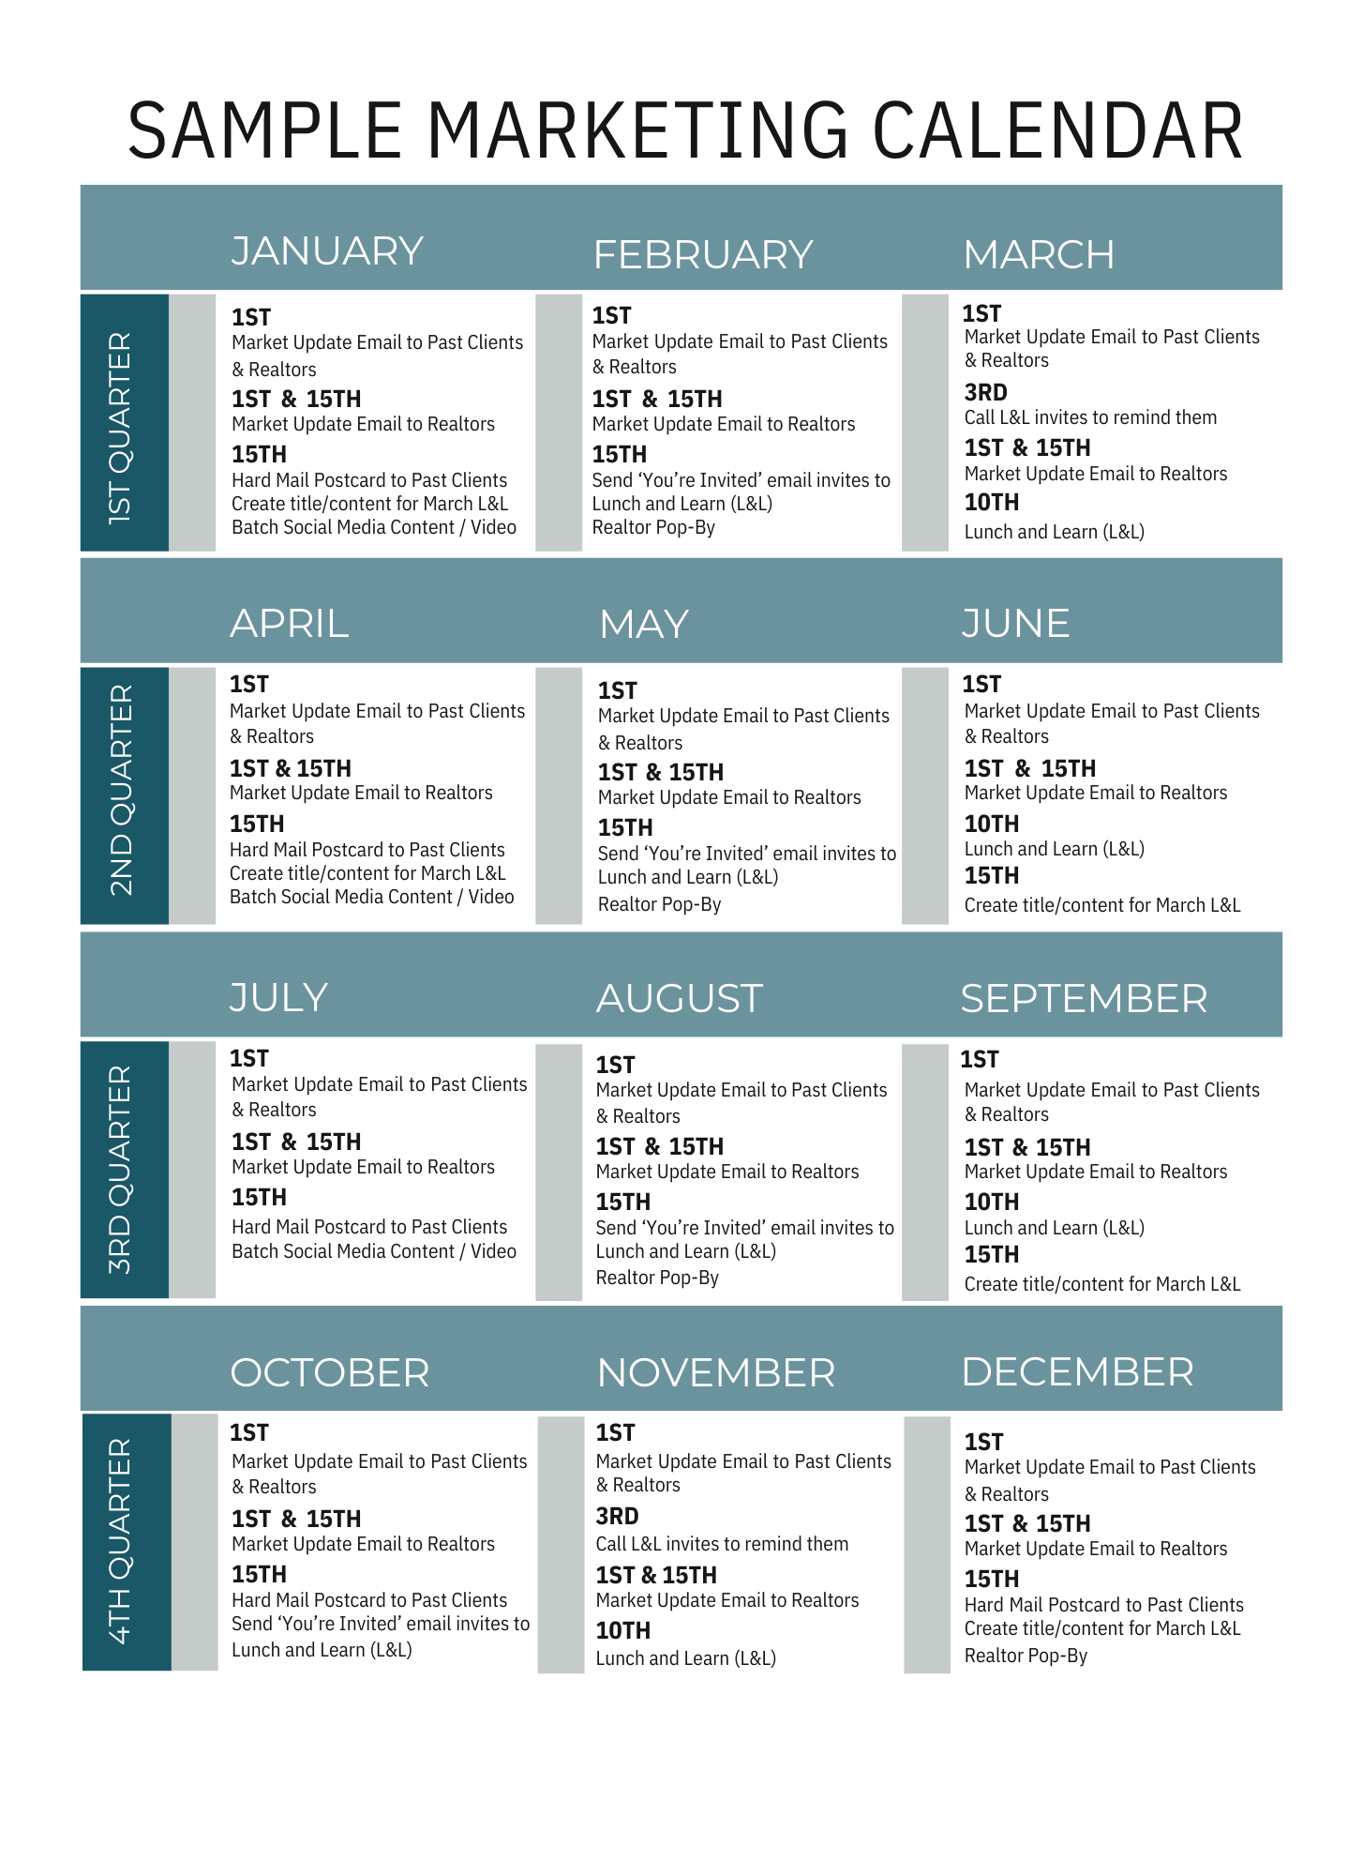

Slide 13
ACTIVITIES FOR OBTAINING MORE BUSINESS FROM NEIGHBORHOOD GROUPS | HOAS:
Create Database to entire neighborhood and develop mailings
Publish and Send Neighborhood Housing Sales Activity, Days on Market, Area Market Trends
Develop and announce neighborhood contests and events
Coordinate and manage Back-to-School drives for supplies, coats, etc = doesn't have to be your neighborhood
Introduce area businesses to the neighborhood and do drawings for coupons for their service
Write and publish Subdivision newsletter
Sponsor HOA events and meetings
Develop and mail offers for Comparative Market Analysis - offer to keep your neighborhood up to date on Area Sales

Slide 14
ACTIVITIES FOR OBTAINING MORE BUSINESS FROM NEIGHBORHOOD GROUPS | HOAS (CONT.):
Create and brand Yard of Month standards, and announce and award yard signs for winners
Coordinate and manage local Bunco and Bingo Groups and events
Coordinate with local police for Safety Days, Tips, and Awareness
Coordinate a Shred Day, and develop a list with local CPA of what to shred, and mail with date/place - co-brand with CPA
Create, manage, and distribute Welcome Neighbor basket. Publish pictures of new neighbors. Establish committee
Create and distribute subdivision Newsletter
Coordinate and sponsor Picture Day with Santa Claus, Easter Bunny, Area athletes in their particular sports season
Create a Lending Library for the Neighborhood

Slide 15
ACTIVITIES FOR OBTAINING MORE BUSINESS FROM NEIGHBORHOOD GROUPS | HOAS (CONT.):
Door to Door handout promos for Hollidays - pumpkin giveaway, Ornament giveaway with your Branded Seasonal card
Attend all HOA Meetings and participate - offer to send notes to neighborhood if there is no officer position
Attend all neighborhood events when public or invited - sponsor Bounce House for kids - have a booth
Use Strategic Gifting
Connect with all neighbors on all social media platforms
Coordinate, advertise and supply signage with your brand for Neighborhood Garage Sale
Coordinate and manage an On-Line Auction for high profile items/donations as a Fund-Raiser for Neighborhood Party/Bash
Develop, print, and distribute Neighborhood Business Directory - Doorknock or send invitation to all to participate

Slide 16
ACTIVITIES FOR OBTAINING MORE BUSINESS FROM COMMUNITY SPONSORSHIPS:
Sponsor, manage, and market on NextDoor app
Research area chambers for events and Attend/Sponsor
Create booths and giveaways for Arbor Day, Area Art and Concerts in the Park, Race Days, etc
Coordinate an Area Senior Day and bring information on Down-sizing, Coordinate with your Loan Officer for Reverse Mortgage
Interview Area Business Owners and post to Social Media
Use Strategic Gifting to area Leaders
Sponsor menus and coffee cups at area restaurants
Sponsor area shopping carts and grocery store lobby displays

Slide 17
ACTIVITIES FOR OBTAINING MORE BUSINESS FROM COMMUNITY SPONSORSHIPS (CONT.):
Write a book of tips and information to First Time Homebuyers and Coordinate a Book Signing at area bookstores
Coordinate and Manage Community Open Houses at Police and Fire Stations
Develop, Coordinate and Manage a Charity Night/Gala to support your favorite Charity/Research Project
Coordinate with Local Pet Stores for Adoption Day, and Picture Day for pets

Slide 18
ACTIVITIES FOR OBTAINING MORE BUSINESS FROM OPEN HOUSES:
Doorknock and Hand deliver invitations to surrounding residences
Co-Brand with your Loan Officer and post to Social Media for more Engagement
Announce a Special Preview time for Family and Friends
Guess & Win Game - visitors guess price the home with SELL for at sign in and you give out a prize & follow-up
Invite your Loan Officer to Attend to visit with guests and supply information on How to Qualify, Market Trends, etc
Have printed information about all available homes in the Area
Be familiar with Stats on the house - builder, year built, custom amenities, local parks and recreation, area school stats

Slide 19
ACTIVITIES FOR OBTAINING MORE BUSINESS FROM OPEN HOUSES (CONT.):
Coordiinate with your loan officer on a follow-up system and report back to each other
Write a book of tips and information to Homebuyers and Bring Signed copies of it to giveaway
Use Multiple directional signs at all entrances and turns, use red & yellow balloons for attention - doesn't have to match brand
Auto Capture visitor information with a QR Code they can scan - cross deliver your information to them

Slide 20
ACTIVITIES FOR OBTAINING MORE BUSINESS FROM PAST CLIENTS | DATABASE:
Friend/Connect to all on Social Media and comment and share with them
Mail Anniversary and Birthday Cards
Call Once a Quarter for personal engagement and ask for referrals
Throw Housewarming and Anniversary parties and invite relatives and friends
Use CRM with drip for lifestyle tips, reminders, home values, etc
Exchange 25 Business Cards for a mutual referral system -If they Own a Business, and ask them to define their best client
Develop a referral program and announce contests and prizes
Use Strategic Gifting
Throw annual client appreciation Party/Dinner - include Plus One if they are single

Slide 21
ACTIVITIES FOR OBTAINING MORE BUSINESS FROM FOR SALE BY OWNER CONVERSIONS:
Coordinate referral program with Local Handymen and Home Vendors
Research comps, and develop value analysis before contact
Develop and Deliver 5 separate touches to the homeowner and follow-up for the conversion
Obtain their Email addresses and send TikTok videos to show your expertise and engagement
Develop an Open House Safety Tips brochure for awareness and deliver
Ask if they own a business and how you can support it - exchange 25 business cards
Use Strategic Gifting
Offer a flat fee service to review contract offers in exchange for Buyers Rep Agreement for their future purchase

Slide 22
ACTIVITIES FOR OBTAINING MORE BUSINESS FROM FRIENDS AND FAMILY:
Write personal Notes to all with Cards and Offer your Services
Create and Friends and Family Referral Program and announce
Make sure you are Connected and Engaged on all Social Media Platforms
Develop Contests with Prizes for the younger generation - best Christmas pajamas, Coloring Contests - everyone wins
Coordinate and Manage a ZOOM Trivia Game - include all relatives around the country
Obtain their Email addresses and send TikTok videos to show your expertise and engagement
Exchange 25 Business Cards for a mutual referral system If they own a business - ask them to define their best client
Coordinate and sponsor a Family Reunion, Sports Event, or Movie Night
Use Strategic Gifting
Create a Family Only Facebook page and manage/invite/engage

Slide 23
ACTIVITIES FOR OBTAINING MORE BUSINESS FROM KIDS' SPORTS TEAMS:
Sponsor shirts and banners for added visibility
Coordinate autograph signings by professional athletes to your community team
Coordinate a sports camp from older athletes to younger ones
Coordinate and manage a fundraiser for the team - car wash, serve at a restaurant, sell area coupons, etc…
Volunteer at Concession Stands - have your branded banner
Coordinate and sponsor Coach Appreciation Day and invite all parent/family to attend
Use strategic gifting to parents
Coordinate a special Half-time with area high school band

Slide 24
ACTIVITIES FOR OBTAINING MORE BUSINESS FROM PARENT GROUPS | YOUR KIDS' ACTIVITIES:
Create Booths and Contest/Giveaways for Area School Carnivals
Develop a School Reading Program and Volunteer/Find other Volunteers
Sponsor your kids, or Grandkids sports team with shirts, banners - be more visible
Start a small group for parents in your home or amenity center regarding common interests, issues, concerns
Join School boosters and sponsor branded banners for visibility
Coordinate Christmas wrapping day for Area Elementary Schools
Exchange 25 Business Cards for a mutual referral system If they own a business - ask them to define their best client
Volunteer with signage at Concession Stands
Use strategic gifting to parents

Slide 25
ACTIVITIES FOR OBTAINING MORE BUSINESS FROM CLUB MEMBERSHIPS:
Sponsor Club directory and place visible ad on your brand and expertise
Sponsor special event dinners and socials for holidays
Sponsor Wine and Whiskey tastings
Coordinate a Business Networking Group/Rainmakers' Group within the Club
Exchange 25 Business Cards for a mutual referral system If they own a business - ask them to define their best client
Join Membership committee and connect with all members
Coordinate and Manage a Christmas Box project for Underpriviledged children or/and Overseas Military
Use strategic gifting to business leaders
Connect with all members on Social media platforms

Slide 26
ACTIVITIES FOR OBTAINING MORE BUSINESS FROM NETWORKING GROUPS:
Research and join area Networking groups for Visibility - OR - Create your own on MeetUp or other Social Media
Develop education pieces on Real Estate Values and Sales Activity & distribute to group
Attend regularly and bring guests for added engagement
Have branded promo items for each guest together with your information/card
Take Officer and Leadership positions for added visibility
Announce your Open Houses and Events to the group
Exchange 25 Business Cards for a mutual referral system - ask them to define their best client
Use strategic gifting to business leaders/owners
Arrange to meet Group members separately outside of meeting for a better relationship and understanding of their business

Slide 27
Reach out to us!
Your Name | NMLS XXXXX
youremailaddress@domain.com
Your Title
(XXX) XXX-XXXX
Add your photo here

